Slide 1
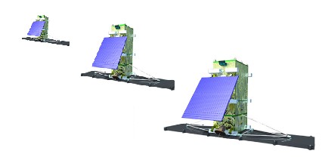
ISO/TS 19159-4 Calibration and validation of remote sensing imagery sensors — Part 4: Space-borne microwave radiometers
1
2
3
Zoom Virtual Meeting
6, May 2021, 9:00 am Eastern Time, 14:00 UTC

Slide 2
Outline
Updates since last meeting
The application of several parameters
Next step

Slide 3
Update Since last meeting
Demonstrated the application of several parameters.
No. | Line | Line
1 | USBLimit & LSBLimit | Lines 26, 27
2 | polarizationMode | Lines 28
3 | spectralResponseFunction (SRF) | Lines 32
4 | Nonlinearity | Lines 63

Slide 4
The application of several parameters (1) USBLimit & LSBLimit
These are band limits of a channel of a microwave radiometer.
For example, from Table 1 below, we can infer that:
USBlimit =[121.1554, 121.3474], and LSBlimit=[116.1526,116.3447].
Table 1 is for a DSB (Double Side Band) radiometer; for a SSB (Single Side Band) radiometer, LSBlimit is the same as USBlimit.
Table 1: An example of the channel 7 of MWHS on FY-3D satellite. with a bandwidth of 0.192GHz at each band
Band | Frequency(GHz) | Band response function (Weights)
LSB | 116.1526 | 0.034773
 | 116.1674 | 0.039172
 | 116.1821 | 0.041576
 | 116.1969 | 0.041576
 | 116.2117 | 0.046835
 | 116.2265 | 0.046835
 | 116.2412 | 0.036907
 | 116.256 | 0.036907
 | 116.2708 | 0.034773
 | 116.2856 | 0.034773
 | 116.3003 | 0.030869
 | 116.3151 | 0.029084
 | 116.3299 | 0.024326
 | 116.3447 | 0.021594
Band | Frequency(GHz) | Band response function (Weights)
USB | 121.1554 | 0.021594
 | 121.1701 | 0.024326
 | 121.1849 | 0.029084
 | 121.1997 | 0.030869
 | 121.2145 | 0.034773
 | 121.2292 | 0.034773
 | 121.2440 | 0.036907
 | 121.2588 | 0.036907
 | 121.2736 | 0.046835
 | 121.2883 | 0.046835
 | 121.3031 | 0.041576
 | 121.3179 | 0.041576
 | 121.3327 | 0.039172
 | 121.3474 | 0.034773

Slide 5
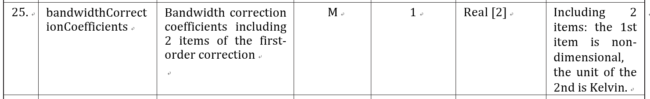
The application of several parameters (1) USBLimit & LSBLimit cont.
How to use these two parameters?
They are used for computing bandwidthCorrectionCoefficients (Line 25 in the data dictionary) for hotTargetTB and coldTargetTB (Line 34 & 35 in the data dictionary) in advance in CA_SCF. IF SRF is given from the sensor’s manufacturer, the band limit can be informed for them; but this is NOT the general case for band limits.

Slide 6
The application of several parameters (2) polarizationMode
For microwave remote sensing, under the Rayleigh-Jeans approximation, the modified Stokes parameters in brightness temperature (TB) are given by:
where T_{v}, T_{h}, T₃ and T₄ are, respectively, the vertically and horizontally polarized and the third and fourth Stokes parameters.
When we have a TB to be calibrated, we should also declare the corresponding polarization mode. Therefore, polarizationMode is one choice from the set {‘v-pol’,’h-pol’,’U-pol’,’V-pol’}. For example, if polarizationMode=’h-pol’, we can know that the TB is the horizontally polarization TB. Each TB to be calibrated is accompanied by a “polarizationMode”.

Slide 7
The application of several parameters (3) spectralResponseFunction (SRF)
SRF is defined as:
<frequency><real>;
<weight><real>
How to use the SRF?
Tb_{weighted}=function(tb(frequency),weights)
where tb(frequency) refer to TBs at each frequency in the table.
Band | Frequency(GHz) | Band response function (Weights)
LSB | 116.1526 | 0.034773
 | 116.1674 | 0.039172
 | 116.1821 | 0.041576
 | 116.1969 | 0.041576
 | 116.2117 | 0.046835
 | 116.2265 | 0.046835
 | 116.2412 | 0.036907
 | 116.256 | 0.036907
 | 116.2708 | 0.034773
 | 116.2856 | 0.034773
 | 116.3003 | 0.030869
 | 116.3151 | 0.029084
 | 116.3299 | 0.024326
 | 116.3447 | 0.021594
Band | Frequency(GHz) | Band response function (Weights)
USB | 121.1554 | 0.021594
 | 121.1701 | 0.024326
 | 121.1849 | 0.029084
 | 121.1997 | 0.030869
 | 121.2145 | 0.034773
 | 121.2292 | 0.034773
 | 121.2440 | 0.036907
 | 121.2588 | 0.036907
 | 121.2736 | 0.046835
 | 121.2883 | 0.046835
 | 121.3031 | 0.041576
 | 121.3179 | 0.041576
 | 121.3327 | 0.039172
 | 121.3474 | 0.034773

Slide 8
The application of several parameters (3) spectralResponseFunction (SRF) cont.
Two notes on SRF:
① SRF is an error source which has been long neglected till recently. The table of SRF is NOT necessarily be given from manufacturer of the sensor, so the weight is often treated as a rectangle function (no weight), where only the band limits are required.
② The parameter spectralResponseFunction is usually used in TA calibration stage, so it would be clearer and easier to be implemented if it is shifted from Table B.4 (Auxiliary Data) to Table B.6 (TA calibration) in the data dictionary (and shifted in the UML accordingly).
SRF been given
SRF not given

Slide 9
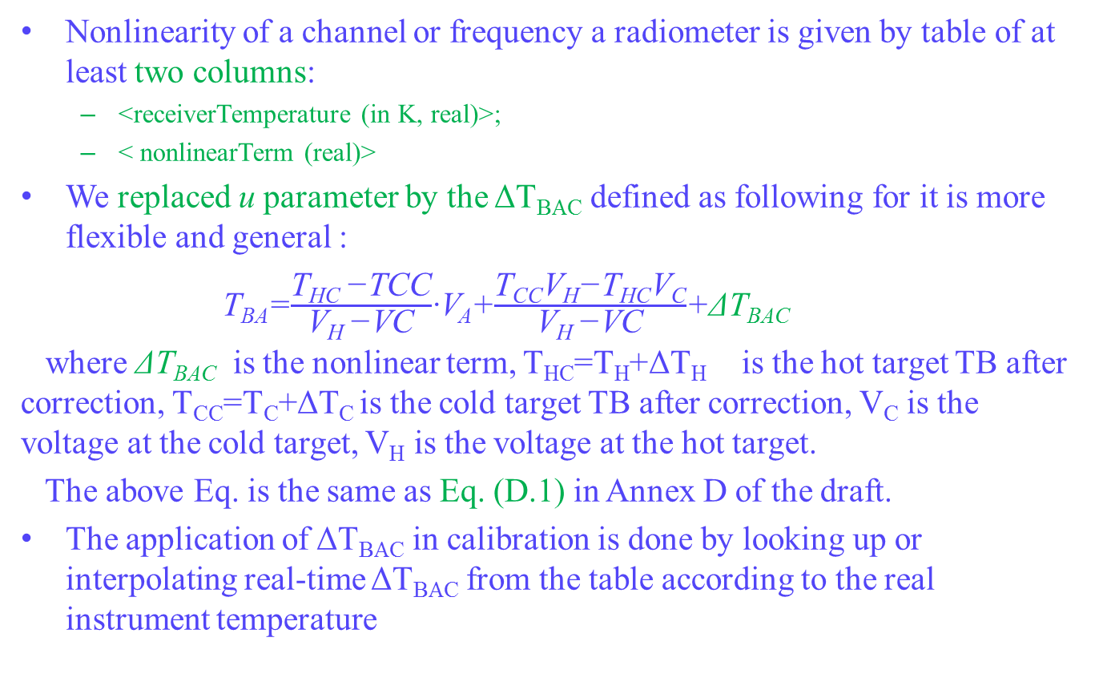
The application of several parameters (4) Nonlinearity
Nonlinearity of a channel or frequency a radiometer is given by table of at least two columns:
<receiverTemperature (in K, real)>;
< nonlinearTerm (real)>
We replaced u parameter by the ΔT_{BAC} defined as following for it is more flexible and general :
T_{BA}=$\frac{\text{T}\text{HC} \text{−}\text{TCC}}{\text{V}\text{H} \text{−}\text{VC}}$·V_{A}+$\frac{\text{T}\text{CC}\text{V}\text{H}\text{−}\text{THCVC}}{\text{V}\text{H}\text{ −}\text{VC}}$+ΔT_{BAC}
where ΔT_{BAC} is the nonlinear term, T_{HC}=T_{H}+ΔT_{H} is the hot target TB after correction, T_{CC}=T_{C}+ΔT_{C} is the cold target TB after correction, V_{C} is the voltage at the cold target, V_{H} is the voltage at the hot target.
The above Eq. is the same as Eq. (D.1) in Annex D of the draft.
The application of ΔT_{BAC} in calibration is done by looking up or interpolating real-time ΔT_{BAC} from the table according to the real instrument temperature

Slide 10
Next step
i. Completely finalize the data dictionary as soon as possible, and send a copy of the finalized document to Tobias when complete, if he has no further comment.
The DataType “Vector” throughout the data dictionary may be inappropriate, so how should we revise these items?
ii. Absorb the latest TMG comments from Reese (if it is available).
iii. After sending (i) and (ii), invite Tobias to ensure UML and data dictionary consistencies, and xml is in order.
iv. Prepare a deck for the pre-plenary meeting.

Slide 11
Thank you

